Slide 1
Intrusion Detection
Lesson Introduction
Part of network defense-in-depth
System architecture, algorithms, and deployment strategies of Intrusion detection
Performance metrics
Attacks on intrusion detection systems
Notes:
Intrusion detection is part of the network defense-in-depth mechanisms.
In this lesson, we will discuss the system architectures, algorithms, deployment strategies and performance metrics of intrusion detection.
We will also discuss attacks on intrusion detection systems.

Slide 2
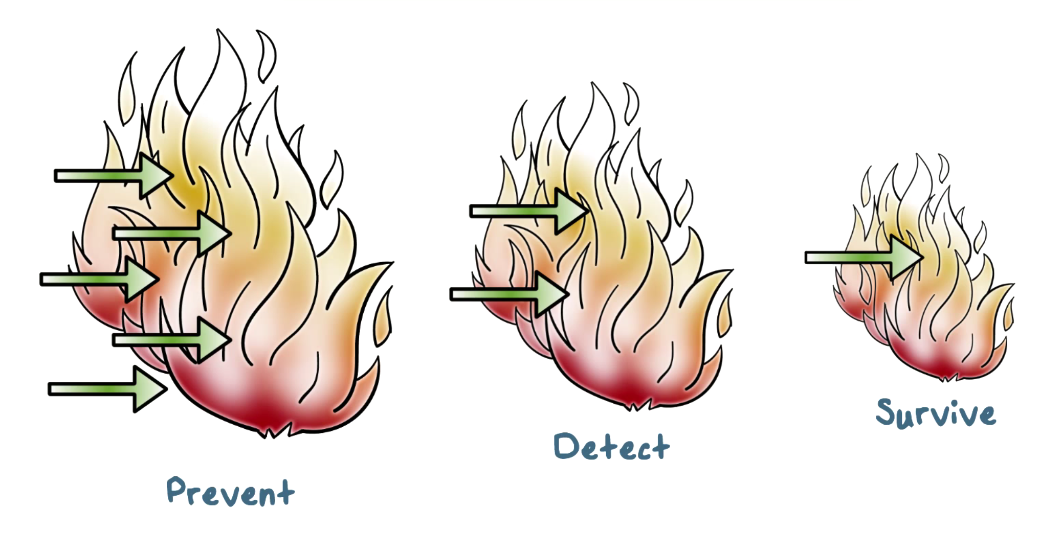
Defense-in-Depth
Notes:
Recall the defense-in-depth principle: we need multiple layers of defense mechanisms. That is, we need detection mechanisms even after we have deployed prevention mechanisms to detect attacks that can’t be easily prevented, or, kept out of our networks and systems.
We’ve discussed firewalls, a prevention mechanism. Today we discuss detection mechanisms. Typically, these mechanisms are called intrusion detection systems.

Slide 3

Intrusion Examples
Running a packet sniffer
Remote root compromise
Distributing pirated software
Web server defacement
Guessing/cracking passwords
Using an unsecured modem to access internal network
Copying databases containing credit card numbers
Impersonating an executive to get information
Viewing sensitive data without authorization
Using an unattended workstation
Notes:
By intrusion, we mean any attack that aims to compromise the security goals of an organization.
For example:
• Performing a remote root compromise of an e-mail server
• Defacing a Web server with inappropriate web contents
• Guessing and cracking passwords
• Stealing a database containing credit card numbers
• Reading sensitive data, including payroll records and medical information,
without authorization
• Running a packet sniffer on a workstation to capture usernames and passwords
• Using a permission error on an anonymous FTP server to distribute pirated
software and music files
• Dialing into an unsecured modem and gaining internal network access
• Posing as an executive, calling the help desk, resetting the executive’s e-mail
password, and learning the new password
• Using an unattended, logged-in workstation without permission

Slide 4

Intrusion Detection Quiz
Select the characteristic that best describes each network security system.
Type (F) for Firewalls or (I) for IDS:
tries to stop intrusion from happening
tries to evaluate an intrusion after it has happened
watches for intrusions that start within the system
limits access between networks to prevent intrusion
Notes:
QUIZ: Select the characteristics that best match Intrusion Detection System and those that best match Firewalls
SOLUTION:
Firewalls and IDS’s are both part of a network security system. A firewall is designed to prevent an intrusion and an IDS is designed to detect an intrusion.
F - tries to stop intrusion from happening
I - tries to evaluate an intrusion after it has happened
I -watches for intrusions that start within the system
F -limits access between networks to prevent intrusion

Slide 5

Intrusion Detection Systems (IDS)
Designed to Counter Threats:
Effective
Known, less sophisticated attacks
Sophisticated targeted attacks
New, Zero-day exploits
Not effective
Notes:
Intrusion detection systems, or IDSs for short, are designed to aid
countering these types of threats.
They can be reasonably effective against known,less sophisticated attacks, such as those by activist groups or large-scale email scams. They are likely less effective against the more sophisticated, targeted attacks by some criminal or state-sponsored intruders, since these attackers are more likely to use new, zero-day exploits, and to better obscure their activities on the targeted system.

Slide 6


Intrusion Detection Systems (IDS)
Defense-In-Depth Strategies include:
encryption
detailed audit trails
strong authentication and authorization controls
active management of operating systems
application security
Notes:
Because IDSs are not always effective, they need to be part of a defense-in-depth strategy that may also
include encryption of sensitive information, detailed audit trails, strong authentication
and authorization controls, and active management of operating system and
application security.

Slide 7
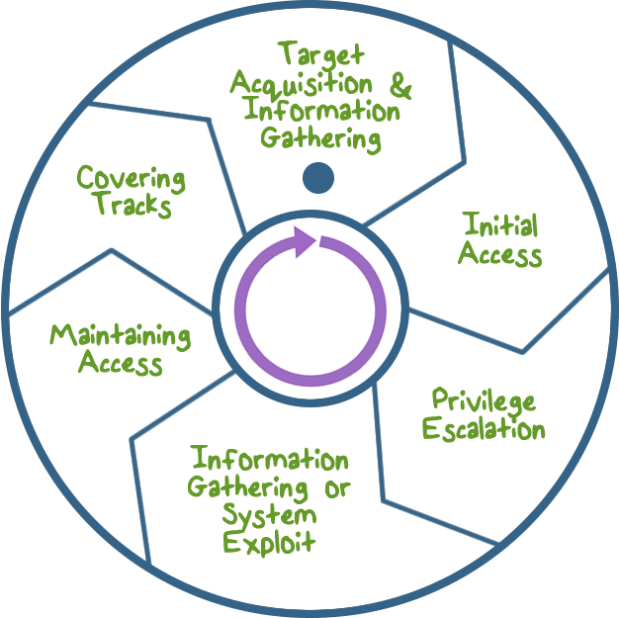
Intruder
Behavior
Notes:
The techniques and behavior patterns of intruders are constantly shifting to exploit newly discovered weaknesses and to evade detection and countermeasures. However, intruders typically use steps from a common attack methodology. Typically the steps are ...
• Target Acquisition and Information Gathering: that is, the attacker identifies and characterizes the target systems using publicly available information, both technical and non-technical, and use network exploration tools to map target resources.
Initial Access: this is typically accomplished by exploiting a remote network vulnerability, e.g., by guessing weak authentication credentials used in a remote service, or via the installation of malware on the system using some form of social engineering or drive-by-download.
• Privilege Escalation: Actions taken on the system, typically via a local access vulnerability, to increase the privileges available to the attacker to enable their more powerful attacks on the target system.
• Information Gathering or System Exploit: Actions by the attacker to access or modify information or resources on the system, or to navigate to another target system.
• Maintaining Access: Actions such as the installation of backdoors or other malicious software, or through the addition of covert authentication credentials or other configuration changes to the system, to enable continued access by the attacker after the initial attack.
• Covering Tracks: Where the attacker disables or edits audit logs, to remove evidence of attack activity, and uses rootkits and other measures to hide covertly installed files or code.

Slide 8
Intruder Quiz
Type True (T) or False (F) for each statement:
An intruder can also be referred to as a hacker or cracker.
Activists are either individuals or members of an organized crime group with a goal of financial reward.
Running a packet sniffer on a workstation to capture usernames and passwords is an example of intrusion.
Those who hack into computers do so for the thrill of it or for status.
Intruders typically use steps from a common attack methodology.
Notes:
QUIZ: Discuss SOLUTION:
Discuss

Slide 9
Types of Backdoors Quiz
Choose the description that best fits each type of backdoor:
A. This backdoor is hard to detect because it modifies machine code.
B. This backdoor can only be used by the person who created it, even if it is discovered by others.
C. This backdoor inserts backdoors into other programs during compilation.
Compiler Backdoors
Object Code Backdoors
Asymmetric Backdoors
Notes:
QUIZ: Professor I don’t know if you want to use this quiz or not -- just skip it if you don’t want two quizzes in a row.
Here’s a quick quiz on backdoors. Chose the description that best fits each type of backdoor. SOLUTION:
Not only can a compiler back door insert a backdoor when compiling a program, it can also detect when it is being compiled itself and re-insert its own backdoor.
Object Code Backdoors are inserted into machine code at either compilation, assembly linking, or loading. These types of backdoors are easier to detect through checksums and disassemblers.
Asymmetric Backdoors can only be used by their creator, even if it is fully exposed. This type of backdoor is part of a field known as cryptovirology and can be very difficult to detect.

Slide 10

Elements of Intrusion Detection
Primary assumptions:
System activities are observable
Normal and intrusive activities have distinct evidence
Notes:
What are the key design elements of the intrusion detection?
First, for intrusion detection to even be possible, we need these assumptions …

Slide 11
Elements of Intrusion Detection
Components of intrusion detection systems:
From an algorithmic perspective:
Features - capture intrusion evidences
Models - piece evidences together
From a system architecture perspective:
Audit data processor, knowledge base, decision engine, alarm generation and responses
Notes:
Then, when it comes to designing an intrusion detection system, we must consider the following …

Slide 12
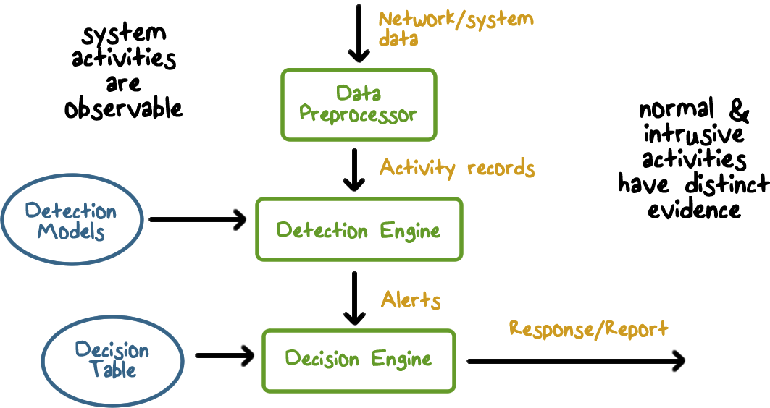
Components of Intrusion Detection Systems
Notes:
Here is an illustration of the workflow of intrusion detection, as well as the main components of an IDS.
The input to an IDS is data that describes activities on systems and network. The data is processed by the Data Preprocessor to extract activity records that are of security interests, and these activity data needs to be analyzed by the Detection Engine, which uses the detection models already constructed for the IDS. If a detection rule determines that there is an intrusion, the IDS produces an alert. The decision engine then decides the appropriate action on the alert, e.g., a response that automatically blocks a network connection, or a report that is sent to the security admin.
Again, for the IDS to work properly, we assume that system activities are observable and are captured in the input data to the IDS, and when detection models are applied to the data, normal and intrusive activities show distinct evidence.

Slide 13

Intrusion Detection Approaches
Modeling and analysis
Misuse detection (a.k.a. signature-based)
Anomaly detection
Deployment
Host-based
Network-based
Development and maintenance
Hand-coding of “expert knowledge”
Learning based on data
Notes:
There are several ways to look at different intrusion detection approaches.
From the point of view of analysis, or, the detection algorithms …
From the point of view of deployment strategy …
From the point of view of development methodology, that is, how the detection models are built and maintained …

Slide 14

Analysis Approaches
Misuse/ Signature Detection
Anomaly Detection
Notes:
IDSs typically use one of the following alternative approaches to analyze sensor
data to detect intrusions:
Anomaly Detection
Misuse/Signature Detection

Slide 15
Analysis Approaches
Anomaly Detection:
Involves the collection of data relating to the behavior of legitimate users over a period of time
Current observed behavior is analyzed to determine whether this behavior is that of a legitimate user or that of an intruder
Notes:
Anomaly detection: Involves the collection of data relating to the behavior of legitimate users over a period of time. Then current observed behavior is analyzed to determine with a high level of confidence whether this behavior is that of a legitimate user or that of an intruder.
In essence, anomaly approaches aim to define or characterize normal, or expected, behaviors, in order to identify malicious or unauthorized behavior.
Signature or heuristic-based approaches directly define malicious or unauthorized behavior. They can quickly and efficiently identify known attacks. However only anomaly detection is able to detect unknown, zero-day attacks, because it starts with known good behavior and identifies anomalies to it.
Given this advantage, clearly anomaly detection would be the preferred approach, were it not for the difficulty in collecting and analyzing the data required, and the high level of false alarms, as we will discuss in the following sections.

Slide 16
Analysis Approaches
Misuse/ Signature Detection
Uses a set of known malicious data patterns or attack rules that are compared with current behavior
Also known as misuse detection
Can only identify known attacks for which it has patterns or rules
Notes:
2. Misuse or Signature detection: Uses a set of known malicious data patterns (signatures) or attack rules that are compared with current behavior to decide if is that of an intruder. It is also known as misuse detection. This approach can only identify known attacks for which it has patterns or rules.

Slide 17
Anomaly Detection Quiz
Check all answers that are true regarding Anomaly detection systems:
The longer the system is in use, the more it learns about network activity.
If malicious activity looks like normal traffic to the system, it will not detect an attack.
False positives can become a problem, normal usage can be mistaken for an attack.
Notes:
QUIZ:
A quiz to check your knowledge of Anomaly detection systems.
SOLUTION:
An anomaly based system must learn what is normal activity. The longer the system is in use, the better it becomes. Unfortunately, this means the network may be unprotected while the profile is being developed.
Attackers can disguise an attack to look like normal network traffic, bypassing the detection system.
False positives can become a problem. Normal activities can trigger an alarm, but putting in a finer profile check can lead to performance issues.

Slide 18
Signature Detection Quiz
Check all answers that are true regarding Signature Based detection:
New threats can be detected immediately.
When a new virus is identified, it must be added to the signature databases
Can only detect an intrusion attempt if it matches a pattern that is in the database
Notes:
QUIZ:
quiz to check your understanding of signature based detection systems.
SOLUTION:
A signature based system requires a database of known viruses. If a virus is not in the database, it will not be detected by the system. It can take anywhere from a few minutes to days after an attack is identified to update the database. Therefore new threats cannot be detected immediately.

Slide 19

A Variety of Classification Approaches
Statistical: Analysis of the observed behavior using univariate, multivariate, or time-series models of observed metrics.
Knowledge Based: Approaches use an expert system that classifies observed behavior according to a set of rules that model legitimate behavior.
Machine Learning: Approaches automatically determine a suitable classification model from the training data using data mining techniques.
Notes:
The anomaly detection approach involves first developing a model of legitimate user behavior by collecting and processing sensor data from the normal operation of the monitored system in a training phase. This may occur at distinct times, or there may be a continuous process of monitoring and evolving the model over time.
Once this model exists, current observed behavior is compared with the model in order to classify it as either legitimate or anomalous activity in a detection phase.
A variety of classification approaches are used, which [GARC09] broadly categorized
as:
• Statistical: Analysis of the observed behavior using univariate, multivariate, or time-series models of observed metrics.
• Knowledge based: Approaches use an expert system that classifies observed behavior according to a set of rules that model legitimate behavior.
• Machine-learning: Approaches automatically determine a suitable classification model from the training data using data mining techniques.

Slide 20


A Variety of Classification Approaches
Issues Affecting Performance:
Efficiency
Cost of Detection
Notes:
They also note two key issues that affect the relative performance of these alternatives, the efficiency and cost of the detection process.

Slide 21
Anomaly Quiz
Which of the following could be considered an anomaly to typical network traffic?
A IP address
A port address
Packet length
Flag setting
Notes:
QUIZ: Let’s make sure we understand what we are looking for when we talk about anomalies with regards to intrusion detection. SOLUTION: All of the answers can be considered to be anomaly to normal network traffic. If the IP address is not one normally accessed by users or is not well known, this is an anomaly.
If the port address is odd or the packet length is unusual then these can also considered worthy of further investigation.

Slide 22

Statistical Approaches
Characteristics:
Use captured sensor data
Multivariate models using time of and order of the event
Advantages:
their relative simplicity
low computation cost
lack of assumptions about expected behavior
Disadvantages:
difficulty selecting suitable metrics
not all behaviors can be modeled using these approaches.
Notes:
The monitored data is first parameterized into desired standard metrics that will then be analyzed. This step ensures that data gathered from a variety of possible sources is provided in standard form for analysis.
Statistical approaches use the captured sensor data to develop a statistical profile of the observed metrics. The earliest approaches used univariate models, where each metric, such as the CPU utilization of a program, was treated as an independent random variable. However this was too crude to effectively identify intruder behavior.
Later, multivariate models considered correlations between the metrics, for example CPU utilization and memory size of a program, which better levels of discrimination observed. Time-series models use the order and time between observed events, for example, user logging into a workstation and an email from the workstation, to better classify the behavior.
The advantages of these statistical approaches include their relative simplicity and low computation cost, and lack of assumptions about behavior expected.
Their disadvantages include the difficulty in selecting suitable metrics to obtain a reasonable balance between false positives and false negatives, and that not all behaviors can be modeled using these approaches.

Slide 23

Knowledge Based Approaches
Developed during training to characterize data into distinct classes
Disadvantages:
The difficulty and time required to develop knowledge from the data
Human experts must assist with the process
Advantages:
Robust
Flexible
Notes:
Knowledge based approaches classify the observed data using a set of rules.
These rules are developed during the training phase, usually manually, to characterize the observed training data into distinct classes.
Formal tools may be used to describe these rules, such as a finite-state machine or a standard description language, such as, a secretary typically only uses office productivity programs such as web browser, email, calendar, and Microsoft Office.
They are then used to classify the observed data in the detection phase.
The advantages of knowledge-based approaches include their robustness and flexibility.
Their main disadvantage is the difficulty and time required to develop high-quality knowledge from the data, and the need for human experts to assist with this process.

Slide 24
Statistical & Knowledge
Based Approaches Quiz
Which of these characteristics describes the statistical approach and which describe a knowledge based approach? Write S or K in the box:
Any action that does not fit the normal behavior profile is considered an attack.
Any action that is not classified as normal is considered to be an attack.
Notes:
QUIZ: Which of these characteristics describes the statistical approach and which describe a knowledge based approach?
SOLUTION: There is a fundamental difference between statistical and knowledge based intruder detection approaches.
Knowledge based approaches use security experts to define the possible normal, or, acceptable behaviors, statistical approaches collect data on normal behavior and learn a profile using an algorithm.

Slide 25

Machine Learning Approaches
Use data mining techniques to develop a model that can classify data as normal or anomalous
Advantages:
Flexibility
Adaptability
Ability to capture interdependencies between observed metrics
Disadvantages:
Dependency on assumptions about accepted behavior
High false alarm rate
High resource cost
Significant time and computational resources
Notes:
Machine-learning approaches automatically develop a model using the labeled normal training data. That is, a machine learning algorithm takes as input examples of normal data and outputs model that is then able to classify subsequently observed data as either normal or anomalous.
The advantages of the machine-learning approaches include their flexibility, adaptability,
and ability to capture interdependencies between the observed metrics.
Their disadvantages include their dependency on assumptions about accepted behavior for a system, their currently unacceptably high false alarm rate, and their high resource cost.
A key disadvantage is that this process typically requires significant time and computational resources. Once the model is generated however, subsequent analysis is generally fairly efficient.

Slide 26
Machine Learning Intruder Detection Approaches
Bayesian networks: Encode probabilistic relationships among observed metrics.
Markov models: Develop a model with sets of states
Notes:
A variety of machine-learning approaches have been tried, with varying success.
These include:
• Bayesian networks: Encode probabilistic relationships among observed events, for example, how likely an email is sent by a user if the current time is 2 AM; if a low probability activity takes place, it anomalous.
• Markov models: Develop a model with sets of states, some possibly hidden, interconnected by transition probabilities. For example, Markove models can be used to model legitimate web site names because the transition probabilities from one letter to the next are similar to that of real dictionary words because users need to type the web site names; a randomly spelled web site name is anomalous and may be used by botnets for command and control.
• Neural networks: Simulate human brain operation with neurons and synapse between them, that classify observed data.
• Clustering and outlier detection: Group the observed data into clusters based
on some similarity or distance measure, and then identify subsequent data as
either belonging to a cluster or as an outlier.

Slide 27
Machine Learning Intruder Detection Approaches
Neural networks: Simulate human brain operation with neurons and synapse between them
Clustering and outlier detection: Group the observed data into clusters then identify subsequent data as either belonging to a cluster or as an outlier.
Notes:
A variety of machine-learning approaches have been tried, with varying success.
These include:
• Bayesian networks: Encode probabilistic relationships among observed events, for example, how likely an email is sent by a user if the current time is 2 AM; if a low probability activity takes place, it anomalous.
• Markov models: Develop a model with sets of states, some possibly hidden, interconnected by transition probabilities. For example, Markove models can be used to model legitimate web site names because the transition probabilities from one letter to the next are similar to that of real dictionary words because users need to type the web site names; a randomly spelled web site name is anomalous and may be used by botnets for command and control.
• Neural networks: Simulate human brain operation with neurons and synapse between them, that classify observed data. These are one of the most powerful algorithms.
• Clustering and outlier detection: Group the observed data into clusters based
on some similarity or distance measure, and then identify subsequent data as
either belonging to a cluster or as an outlier. For example, traffic from the internal network to the company’s internal web server have common characteristics that can be grouped into clusters based on the web pages visited; other the hand, an attack may access data on the web server that is rare requested, which makes it an outlier.

Slide 28
Machine Learning Quiz
Which description best describes the Machine Learning approach for Intruder Detection:
detects new and novel attacks
detects attacks similar to past attacks
Notes:
QUIZ: |Let’s take a moment to think about the Machine Learning approach to Intruder detection.
SOLUTION: Machine learning approach is best at detecting an attack that is similar to a previous, learned attack.

Slide 29
Limitations of Anomaly Detection
They are generally trained on legitimate data
This limits the effectiveness of some of the techniques discussed.
Notes:
A key limitation of anomaly detection approaches used by IDSs, particularly the machine-learning approaches, is that they are generally only trained with legitimate data, unlike many of the other applications surveyed in [CHAN09] where both legitimate and anomalous training data is used. The lack of anomalous training data, which occurs given the desire to detect currently unknown future attacks, limits the effectiveness of some of the techniques we have discussed.

Slide 30
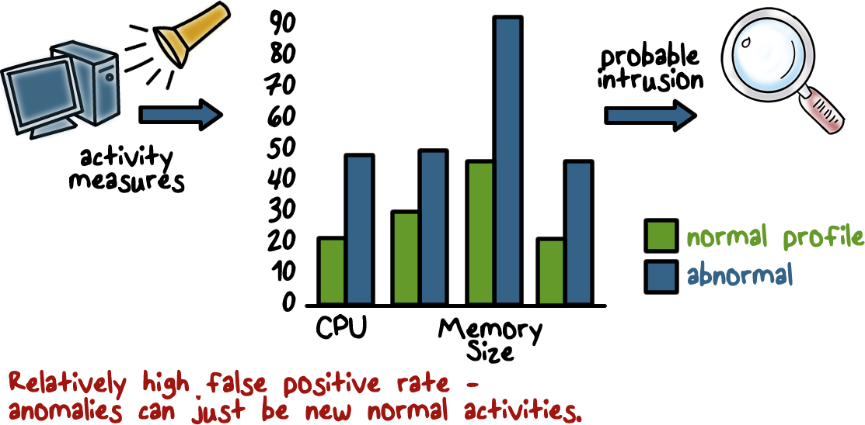
Anomaly Detection Example
Notes:
Here is an example of a very simple anomaly detection approach.
First, establish the normal run-time profile of a program, for example, in terms of CPU utilization, memory size, etc. This can be accomplished by running a program many times, and each time, record the values of these measurements, and then compute the means and variances.
Once the profile is built, when the IDS observes that when the program is run, its measures deviate from the means beyond the allowed thresholds, or, the variances, meaning the values are outside of the normal ranges, the IDS outputs an alert.

Slide 31
Anomalous Behavior Quiz
One of the weaknesses of anomalous intruder
detection is that a system must learn what is
normal behavior. While it is learning this, the
network is vulnerable to attack. What can be done to
mitigate this weakness?
Write your answer in the textbox:
Notes:
QUIZ: discuss
SOLUTION: The weakness can be mitigated by also using a system that checks for known attack methods, such as a Firewall.

Slide 32
Misuse or Signature Detection
Detect intrusion by:
observing events in the system
applying a set of patterns or rules to the data
determining if the is intrusive or normal
Notes:
Signature or heuristic techniques detect intrusion by observing events in the system and applying either a set of signature patterns to the data, to decide whether the observed data indicates intrusive or normal behavior.

Slide 33
Signature Approaches
Match a large collection of known patterns of malicious data against data stored on a system or in transit over a network
The signatures need to be large enough to minimize the false alarm rate, while still detecting a sufficiently large fraction of malicious data
Widely used in anti-virus products, network traffic scanning proxies, and in NIDS
Notes:
Signature approaches match a large collection of known patterns of malicious data against data stored on a system or in transit over a network. The signatures need to be large enough to minimize the false alarm rate, while still detecting a sufficiently large fraction of malicious data. This approach is widely used in antivirus products, in network traffic scanning proxies, and in NIDS.

Slide 34

Signature Approach
Advantages & Disadvantages
Advantages:
Low cost in time and resource use
Wide Acceptance
Disadvantages:
Significant effort to identify and review new malware to create signatures
inability to detect zero-day attacks
Notes:
The advantages of this approach include the relatively low cost in time and resource use, and its wide acceptance.
Disadvantages include the significant effort required to constantly identify and review new malware to create signatures able to identify it, and the inability to detect zero-day attacks for which no signatures exist.

Slide 35

Zero Day Market Place Quiz
In the thriving zero day attack marketplace hackers sell information on software vulnerabilities. Can you guess some of the buyers?
Apple
Google
Microsoft
U.S. Government
Notes:
QUIZ:
Lest you think that an inability to detect zero day attacks is not important, lets do a quiz.
SOLUTION: The black market on zero day vulnerabilities is quite strong. Companies pay hackers to tell them of their vulnerabilities.
A zero day vulnerability in the Linux OS sold for $50,000.

Slide 36

Rule-Based Detection
Involves the use of rules for identifying known penetrations or penetrations that would exploit known weaknesses
Rules can also be defined that identify suspicious behavior
Typically rules used are specific
SNORT is an example of a rule-based NIDS
Notes:
Instead of using only signatures of known attacks, a misuse detection systems can also use a more sophisticated, rule-based approach.
Rule-based detection involves the use of rules for identifying known penetrations or penetrations that would exploit known vulnerabilities.
Rules are specified to process and analyze activity data and match multiple signatures or patterns.
Typically, the rules used in these systems are specific to the machine and operating system.
The most fruitful approach to developing such rules is to analyze attack tools and scripts collected on the Internet.
These rules can be supplemented with rules generated by knowledgeable security personnel. In this latter case, the normal procedure is to interview system administrators and security analysts to collect a suite of known penetration scenarios and key events that threaten the security of the target system.
The SNORT system is an example of a
rule-based NIDS. A large collection of rules exists for it to detect a wide variety of
network attacks.

Slide 37
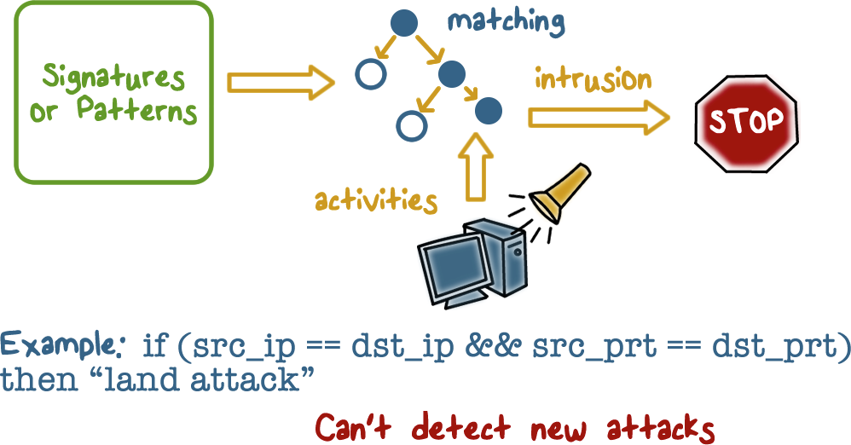
Misuse Signature Intruder Detection
Notes:
Here is an example of a misuse detection approach. The IDS matches the observed activities using a set of attack signatures. If there is match, the IDS outputs an alert.

Slide 38
Attacks Quiz
Write the name of each attack next to it’s definition. The choices are Scanning Attack (S), DOS(D), and Penetration Attack(P).
an attacker sends various kinds of packets to probe a system or network for vulnerability that can be exploited
attempts to slow down or completely shut down a target so as to disrupt the service for legitimate users
an attacker gains an unauthorized control of a system
Notes:
QUIZ: Let’s check our understanding of IDS. Here is a list of attacks that IDS can detect. Match the definition of the attack with it’s name. SOLUTION:
Scanning Attack - an attacker sends various kinds of packets to probe a system or network for vulnerability that can be exploited
Denial of Service - attempts to slow down or completely shut down a target so as to disrupt the service for legitimate users
Penetration Attack - an attacker gains an unauthorized control of a system

Slide 39

Monitoring Networks and Hosts
An IDS performs passive monitoring:
It records and analyzes data about system and network activity
If the IDS sends out an alert AND the response policy dictates intervention, then activities are affected
Notes:
Now, let’s discuss some details of the systems and deployment aspects of intrusion detection.
An IDS performs “passive” monitoring. That is, it records and analyzes data about systems and network activities while these activities continue to take place. Only when the IDS outputs an alert and the response policy dictates a direct intervention, such as blocking a connection or terminating a program, are the activities affected.

Slide 40
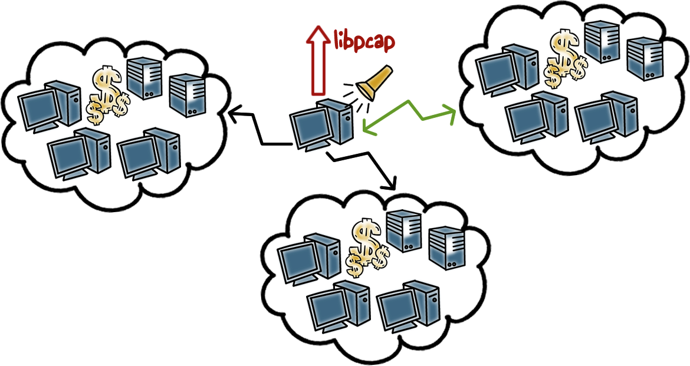
Network IDS
Notes:
An IDS can be deployed at the perimeter of a network or subnet to monitor traffic going in and out of the network. Such an IDS is a network IDS. It uses a packet capturing tool, such as the libpcap, to obtain network traffic data. The packet data contains the complete information about network connections.
For example, if a user connects to a web site using his browser, the packet data will contain all the TCP handshake information between the browser and the web server, and all the URL requests from the browser and the return page contents from the server. That is, by examining the packet data, the IDS has all the data sent and received by the user’s browser.
If the user’s machine is infected by a bot malware, for example, if it attempts to connect to a web site for command and control, the network IDS will be able to see that the traffic looks like C&C activities and output an alert.

Slide 41
Network Based IDS (NIDS)
Monitors traffic at selected points on a network in real or close to real time
May examine network, transport, and/or application-level protocol activity
Comprised of a number of sensors, one or more servers for NIDS management functions, and one or more management consoles for the human interface
Analysis of traffic patterns may be done at the sensor, the management server or a combination of the two
Notes:
Let’s discuss more about network IDS, or NIDS.
A network-based IDS (NIDS) monitors traffic at selected points on a network or interconnected set of networks. The NIDS examines the traffic packet by packet in real time, or close to real time, to attempt to detect intrusion patterns. The NIDS may examine network-, transport-, and/or application-level protocol activities. Note the contrast with a host-based IDS; a NIDS examines packet traffic directed toward potentially vulnerable computer systems on a network.
A typical NIDS facility includes a number of sensors to monitor packet traffic, one or more servers for NIDS management functions, and one or more management consoles for the human interface. The analysis of traffic patterns to detect intrusions may be done at the sensor, at the management server, or some combination of the two.

Slide 42
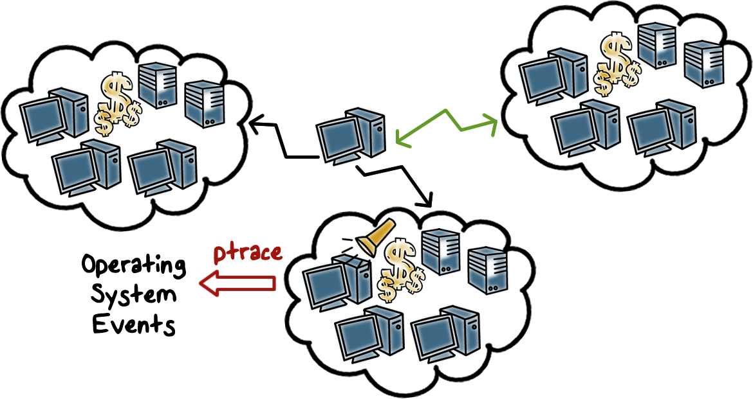
Host IDS
Notes:
An IDS can also be deployed at an end-host, and such an IDS is a host-based IDS. It can use a variety of data on systems activities. For example, most host-based IDSs use ptrace to obtain the system calls made by a program to monitor the behaviors of the program. System call data is very useful to security monitoring because whenever a program requests a resource, such as memory allocation, access to the filesystem, networks, and I/O devices, it needs to make a system call to the operating system because the OS manages the system resources. That is, most of the “interesting” or “useful” activities by a program are carried out through systems calls. For example, if the user’s browser receives a page with a malicious Javascript that is able to break the protection in the browser and attempts to overwrite the windows registry file, the IDS will observe a “write” system call to the registry file, and can decide that this is an anomaly.

Slide 43
NIDS QUIZ
Can you think of a way to reduce the impact of excessive reporting on a system’s administrator?
Write your answer in the textbox:
Notes:
QUIZ: One issue with NIDS is excessive reporting of attacks caused by each case of misuse is reported. There can be so many reports it becomes impossible look at all of them.
Can you think of a way to reduce the impact on an administrator?
SOLUTION:
One method is to prioritize the alerts by adding a security level. The security level is based on the seriousness of the attack and the accuracy of the signature. For example, if a signature creates more than 90% false positives, then even a serious attack can be assigned a low level of threat.

Slide 44

Inline Sensors
Used to block an attack when one is detected, performing both intrusion detection and prevention functions
An inline sensor is inserted into a network segment so that the traffic that it is monitoring must pass through the sensor.
Notes:
One type of IDS configuration is inline sensors. The primary motivation for the use of inline sensors is to enable them to block an attack when one is detected. In this case the device is performing both intrusion detection and intrusion prevention functions.
Sensors can be deployed in one of two modes: inline and passive. An inline sensor is inserted into a network segment so that the traffic that it is monitoring must pass through the sensor.

Slide 45
Inline Sensors
Can be achieved by:
Combining NIDS sensor logic with a firewall or LAN switch. This has the advantage of no additional hardware is needed
Using a stand-alone inline NIDS sensor
Notes:
One way to achieve an inline sensor is to combine NIDS sensor logic with another network device, such as a firewall or a LAN switch. This approach has the advantage that no additional separate hardware devices are needed; all that is required is NIDS sensor software.

Slide 46

Passive Sensors
A passive sensor monitors a copy of network traffic; the actual traffic does not pass through the device
Passive sensors are more efficient
Notes:
More commonly, passive sensors are used. A passive sensor monitors a copy of network traffic; the actual traffic does not pass through the device. From the point of view of traffic flow, the passive sensor is more efficient than the inline sensor, because it does not add an extra handling step that contributes to
packet delay.

Slide 47
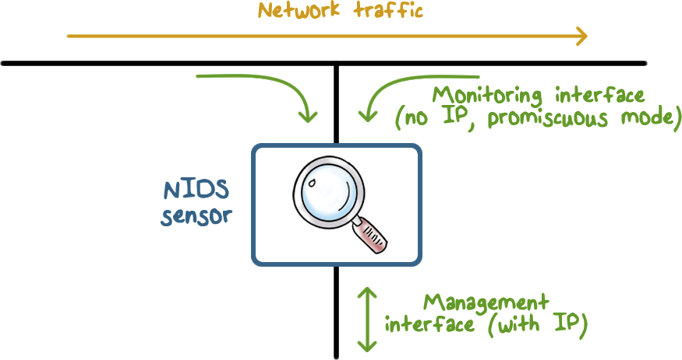
Passive Sensors
Notes:
This illustrates a typical passive sensor configuration. The sensor connects to the network transmission medium, such as a fiber optic cable, by a direct physical tap. The tap provides the sensor with a copy of all network traffic being carried by the medium. The network interface card (NIC) for this tap usually does not have an IP address configured for it. All traffic into this NIC is simply collected with no protocol interaction with the network. The sensor has a second NIC that connects to the network with an IP address and enables the sensor to communicate with a NIDS management server.

Slide 48

Firewall Versus Network IDS
Network IDS
Passive monitoring
Fail-open
Firewall
Active filtering
Fail-close
Notes:
Protection is not free/cheap. For example, an intrusion detection system (IDS) needs to analyze each packet. This requires a lot of computing power, usually a dedicated high-end workstation. If the IDS is real-time then its response time must be short.
When there is insufficient resources, some protection mechanisms will simply not let data in (fail-close). For example, a firewall, which filters each packet, will simply drop packets when it is overloaded. The dropped packet will not be able to reach beyond the firewall into the internal network. The user experience may not be a happy one because of data loss.
However, other protection mechanisms will check/analyze as much as they can but will effectively let all data (fail-open) when there is insufficient resources. For example, an IDS, which simply copies a packet and analyzes it (while the packet continues to reach its target), may only be able to check a packet after a lengthy delay when it is overloaded, letting the packet to complete its potentially malicious actions.

Slide 49
IDS Quiz
Put a (T) for True next to each true statement and a (F) for False next to each false statement.
Intrusion detection is based on the assumption that the behavior of the intruder differs from that of a legitimate user in ways that can be quantified.
The primary purpose of an IDS is to detect intrusions, log suspicious events, and send alerts.
Signature-based approaches attempt to define normal, or expected, behavior, whereas anomaly approaches attempt to define proper behavior.
An network IDS sensor monitors a copy of network traffic; the actual traffic does not pass through the device.
Network-based intrusion detection makes use of signature detection and anomaly detection.
Notes:
QUIZ: Discuss
SOLUTION: Discuss

Slide 50
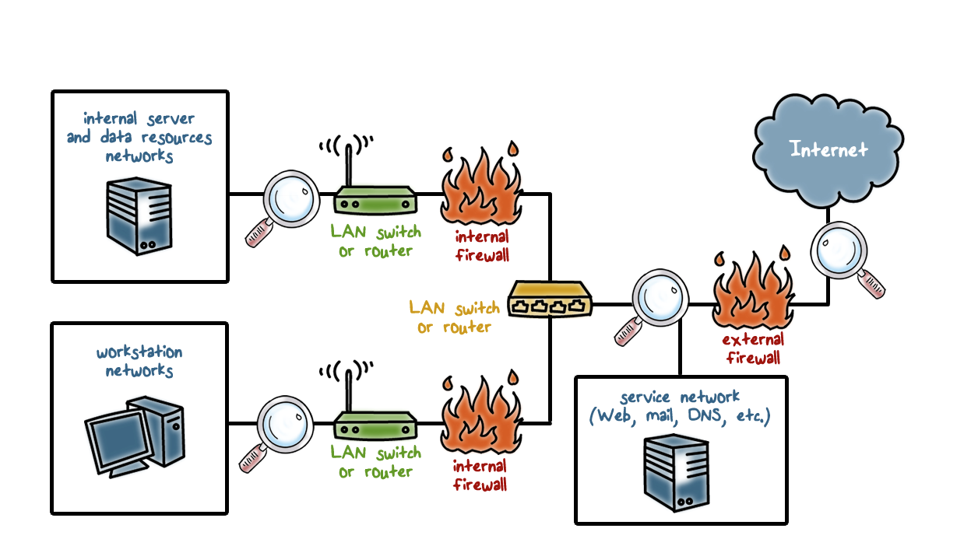
NIDS Sensor Deployment
Notes:
PART 1
Consider an organization with multiple sites, each of which has one or more LANs, with all of the networks interconnected via the Internet or some other WAN technology. For a comprehensive NIDS strategy, one or more sensors are needed at each site. Within a single site, a key decision for the security administrator is the placement of the sensors.
PART 2
In any given network there are a number of possibilities. In general terms, this configuration is typical of larger organizations. All Internet traffic passes through an external firewall that protects the entire facility. Traffic from the outside world, such as customers and vendors that need access to public services, such as Web and mail, is monitored.
The external firewall also provides a degree of protection for those parts of the network
that should only be accessible by users from other corporate sites. Internal firewalls may also be used to provide more specific protection to certain parts of the network.
PART 3
A common location for a NIDS sensor is just inside the external firewall
( location 1 in the figure). This position has a number of advantages:
PART 4
• Sees attacks, originating from the outside world, that penetrate the network’s perimeter defenses (external firewall).
• Highlights problems with the network firewall policy or performance.
• Sees attacks that might target the Web server or ftp server.
• Even if the incoming attack is not recognized, the IDS can sometimes recognize the outgoing traffic that results from the compromised server
PART 5
Instead of placing a NIDS sensor inside the external firewall, the security administrator may choose to place a NIDS sensor between the external firewall and the Internet or WAN ( location 2 ). In this position, the sensor can monitor all network traffic, unfiltered.
PART 6
The advantages of this approach are as follows:
• Documents number of attacks originating on the Internet that target the network
• Documents types of attacks originating on the Internet that target the network
A sensor at location 2 has a higher processing burden than any sensor located elsewhere on the site network.
PART 7
In addition to a sensor at the boundary of the network, on either side of the
external firewall, the administrator may configure a firewall and one or more sensors
to protect major backbone networks, such as those that support internal servers
and database resources ( location 3 ). The benefits of this placement include the
following:
PART 8
• Monitors a large amount of a network’s traffic, thus increasing the possibility
of spotting attacks
• Detects unauthorized activity by authorized users within the organization’s
security perimeter
PART 9
Thus, a sensor at location 3 is able to monitor for both internal and external attacks. Because the sensor monitors traffic to only a subset of devices at the site, it can be tuned to specific protocols and attack types, thus reducing the processing burden.
PART 10
Finally, the network facilities at a site may include separate LANs that support
user workstations and servers specific to a single department. The administrator
could configure a firewall and NIDS sensor to provide additional protection for
all of these networks or target the protection to critical subsystems, such as personnel
and financial networks ( location 4 ). A sensor used in this latter fashion provides
the following benefits:
PART 11
• Detects attacks targeting critical systems and resources
• Allows focusing of limited resources to the network assets considered of
greatest value
As with a sensor at location 3, a sensor at location 4 can be tuned to specific protocols and attack types, thus reducing the processing burden.

Slide 51
NIDS Sensor Deployment Quiz
When using sensors which of the following is considered good practice? Check all the true statements:
Set the IDS level to the highest sensitivity to detect every attack
Monitor both outbound and inbound traffic
Use a shared network resource to gather NIDS data
NIDS sensors are turnkey solutions, system administrators can interpret alerts.
Notes:
QUIZ: Discuss
SOLUTION: Don’t set the level to the highest sensitivity, this will lead to a large number of false positives. Which in turn will result in a complacency about positive alert messages.
Always monitor both inbound and outbound traffic.
Do not use a shared network resource to gather NIDS data. An attacker can disable the IDS or modify the alert that is sent.
NIDS sensors send alerts that can be true or false positives. The interpretation of the alerts requires someone with knowledge of networks and system applications.

Slide 52

SNORT
Open source
Highly configurable
Lightweight IDS
Notes:
Snort is an open source, highly configurable and portable host-based or network-based
IDS. Snort is referred to as a lightweight IDS, which has the following characteristics

Slide 53
SNORT
Characteristics:
Easily deployed on most nodes
Efficient operation
Easily configured by system administrators
Performs real-time packet capture
Detects a variety of attacks and probes
Notes:
• Easily deployed on most nodes (host, server, router) of a network
• Efficient operation that uses small amount of memory and processor time
• Easily configured by system administrators who need to implement a specific security solution in a short amount of time
Snort can perform real-time packet capture, protocol analysis, and content searching
and matching. Snort can detect a variety of attacks and probes, based on a set of
rules configured by a system administrator.

Slide 54
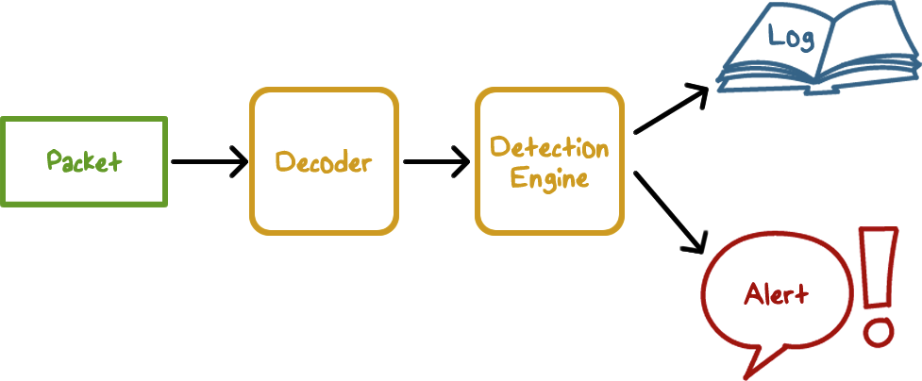
SNORT
Consists of Four Logical Components
Notes:
A Snort installation consists of four logical components ( Figure 8.9 ):
• Packet decoder: The packet decoder processes each captured packet to identify and isolate protocol headers at the data link, network, transport, and application layers.
The decoder is designed to be as efficient as possible and its primary work consists of setting pointers so that the various protocol headers can be easily extracted.
• Detection engine: The detection engine does the actual work of intrusion detection. This module analyzes each packet based on a set of rules defined for this configuration of Snort by the security administrator. In essence, each packet is checked against all the rules to determine if the packet matches the characteristics defined by a rule.
The first rule that matches the decoded packet triggers the action specified by the rule. If no rule matches the packet, the detection engine discards the packet.
• Logger: For each packet that matches a rule, the rule specifies what logging and alerting options are to be taken. When a logger option is selected, the logger stores the detected packet in human readable format or in a more compact binary format in a designated log file. The security administrator can then use the log file for later analysis.
• Alerter: For each detected packet, an alert can be sent. The alert option in the matching rule determines what information is included in the event notification.
The event notification can be sent to a file, to a UNIX socket, or to a database. Alerting may also be turned off during testing or penetration studies.
Using the UNIX socket, the alert can be sent to a management machine elsewhere on the network.

Slide 55
SNORT Configuration
Configured as passive
Monitors traffic
Is not in the main transmission path
Is not an inline sensor
Configured as Intrusion Detection
Notes:
A Snort implementation can be configured as a passive sensor, which monitors
traffic but is not in the main transmission path of the traffic, or an inline sensor,
through which all packet traffic must pass. In the latter case, Snort can perform
intrusion prevention as well as intrusion detection.

Slide 56
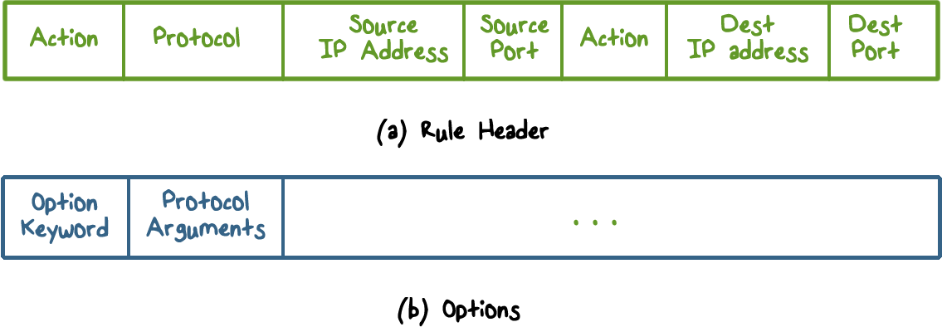
Snort Rules
Notes:
Snort uses a simple, flexible rule definition language that generates the rules used
by the detection engine. Although the rules are simple and straightforward to write,
they are powerful enough to detect a wide variety of hostile or suspicious traffic.
Each rule consists of a fixed header and zero or more options.

Slide 57
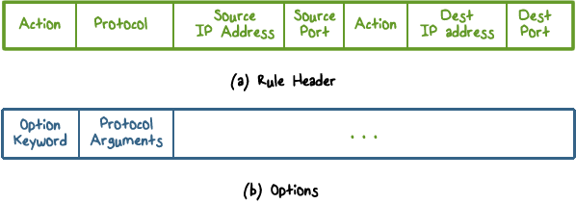
Snort Rule Options
Meta-data: provides information about the rule but do not have any effect during detection
Payload: look for data inside the packet
Non-payload: Look for non-payload data
Post-detection: rule-specific triggers that happen after a rule has matched a packet
Notes:
There are four major categories of rule options:
• meta-data: Provide information about the rule but do not have any effect during detection
• payload: Look for data inside the packet payload and can be interrelated
• non-payload: Look for non-payload data
• post-detection: Rule-specific triggers that happen after a rule has matched a packet

Slide 58
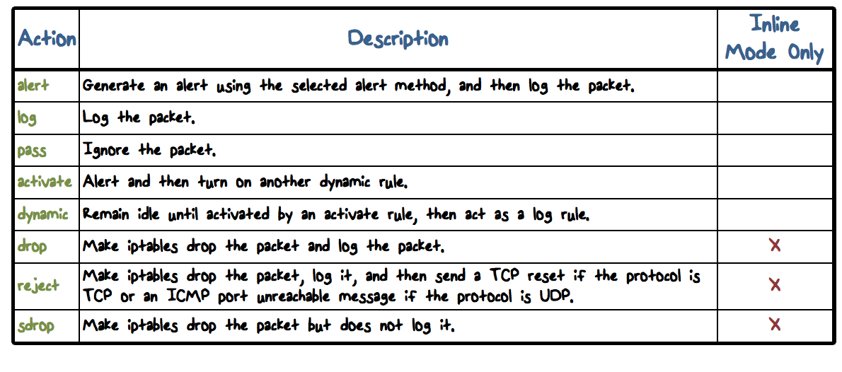
Snort Rule Actions
Notes:
The header has the following elements:
• Action: The rule action tells Snort what to do when it finds a packet that matches the rule criteria. The table lists the available actions.
The last three actions in the list (drop, reject, sdrop) are only available in inline mode.

Slide 59
Snort Rule Actions
Notes:
Following the rule header may be one or more rule options.
Each option consists of:
an option keyword, which defines the option; followed by arguments, which specify the details of the option.
In the written form, the set of rule options is separated from the header by being enclosed in parentheses. Snort rule options are separated from each other using the semicolon (;) character.
Rule option keywords are separated from their arguments with a colon (:) character.

Slide 60
Snort Rule Example:
alert tcp any any -> 192.168.1.0/24 25 (content: “mail from: root”; msg: “root users attempts to send an email”;)
Notes:
Here is an example of Snort rule.
The root user account should be used only for specific privileged systems and network admin operations, such as backing up file systems and setting up sub networks. It is uncommon to send email using the root account, and such an event should trigger an alert.
Here is an example Snort rule. It looks at traffic to the SMTP port on any host in the /24 network, and checks if content of the email payload contains “mail from: root”, which indicates a root user on any machine sending email.
The content keyword is one of the more important features of Snort. It allows the user to set rules that search for specific content in the packet payload and trigger response based on that data.

Slide 61
SNORT Quiz
Check all those who can write rules for SNORT:
Users of SNORT
The SNORT Community
Talos Security Intelligence and Research Team
Notes:
QUIZ: SNORT has the an advantage of detecting zero day attacks by using rules to detect vulnerabilities. Who can write SNORT rules?
SOLUTION: As open source software, everyone can write rules for SNORT. The rules can be submitted for approval by Talos and shared with the SNORT community.

Slide 62


Honeypots
Honeypots are decoy systems designed to lure attackers away from critical systems.
Honeypots are designed to:
divert an attacker
collect information about an attacker
encourage an attacker to stay long enough for administrators to respond
Notes:
A further component of intrusion detection technology is the honeypot. Honeypots are decoy systems that are designed to lure a potential attacker away from critical systems.
Honeypots are designed to:
• Divert an attacker from accessing critical systems.
• Collect information about the attacker’s activity.
• Encourage the attacker to stay on the system long enough for administrators
to respond.

Slide 63
Honeypots
Honeypots are filled with fabricated information
Any accesses to a honeypot trigger monitors and event loggers
An attack against a honeypot is made to seem successful
Notes:
These systems are filled with fabricated information designed to appear valuable but that a legitimate user of the system would not access. Thus, any access to the honeypot is suspect. The system is instrumented with sensitive monitors and event loggers that detect these accesses and collect information about the attacker’s activities. Because any attack against the honeypot is made to seem successful, administrators have time to mobilize and log and track the attacker without ever exposing productive systems.

Slide 64
Honeypots
A honeypot has no production value
There is no legitimate reason to access a honeypot
Any attempt to communicate with a honeypot is most likely a probe, scan, or attack
If a honeypot initiates outbound traffic, the system is most likely compromised
Notes:
The honeypot is a resource that has no production value.
There is no legitimate reason for anyone outside the network to interact with a honeypot.
Thus, any attempt to communicate with the system is most likely a probe, scan, or attack. Conversely, if a honeypot initiates outbound communication, the system has probably been compromised.

Slide 65
Honeypot Classification
Low interaction honeypot:
Emulates particular IT services or systems well enough to provide a realistic initial interaction, but does not execute a full version of those services or systems
Provides a less realistic target
Often sufficient for use as a component of a distributed IDS to warn of imminent attack
Notes:
Honeypots are typically classified as being either low or high interaction.
• Low interaction honeypot: Consists of a software package that emulates particular
IT services or systems well enough to provide a realistic initial interaction,
but does not execute a full version of those services or systems.
A low interaction honeypot provides a less realistic target but are often sufficient for use as a component of a distributed IDS to warn of imminent attack.

Slide 66
Honeypot Classification
High interaction honeypot
A real system, with a full operating system, services and applications, which are instrumented and deployed where they can be accessed by attackers
More realistic target that may occupy an attacker for an extended period
However, it requires significantly more resources
Notes:
• High interaction honeypot: Is a real system, with a full operating system, services and applications, which are instrumented and deployed where they can be accessed by attackers.
A high interaction honeypot is a more realistic target that may occupy an attacker for an extended period. However, it requires significantly more resources, and if compromised could be used to initiate attacks on other systems. This may result in unwanted legal or reputational issues for the organization running it.
“The Honeynet Project” provides a range of resources and packages
for such systems.
Initial efforts involved a single honeypot computer with IP addresses designed
to attract hackers. More recent research has focused on building entire honeypot
networks that emulate an enterprise, possibly with actual or simulated traffic and
data. Once hackers are within the network, administrators can observe their behavior
in detail and figure out defenses.

Slide 67
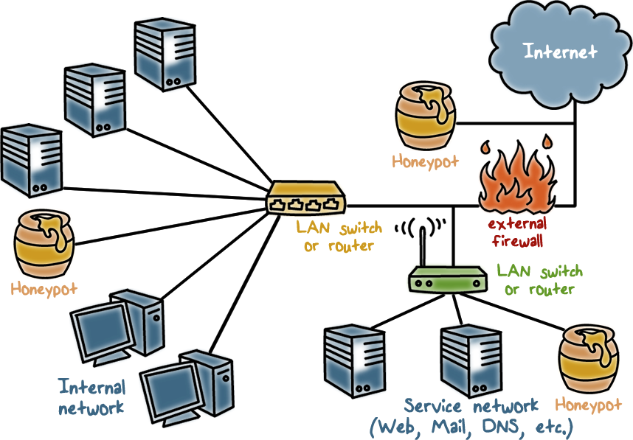
Honeypot Deployment
Notes:
Honeypots can be deployed in a variety of locations. The location depends on a number of factors, such as the type of information the organization is interested in gathering and the level of risk that organizations can tolerate to obtain the maximum amount of data.
A honeypot outside the external firewall ( location 1 ) is useful for tracking attempts to connect to unused IP addresses within the scope of the network.
A honeypot at this location does not increase the risk for the internal network. The danger of having a compromised system behind the firewall is avoided.
Further, because the honeypot attracts many potential attacks, it reduces the alerts issued by the firewall and by internal IDS sensors, easing the management burden. The disadvantage of an external honeypot is that it has little or no ability to trap internal attackers, especially if the external firewall filters traffic in both directions.
The network of externally available services, such as Web and mail, often
called the DMZ (demilitarized zone), is another candidate for locating a honeypot
( location 2 ). The security administrator must assure that the other systems in the
DMZ are secure against any activity generated by the honeypot.
A disadvantage of this location is that a typical DMZ is not fully accessible, and the firewall typically blocks traffic to the DMZ. When the attacker attempts to access unneeded services. Thus, the firewall either has to open up the traffic beyond what is permissible, which is risky, or limit the effectiveness of the honeypot.
A fully internal honeypot ( location 3 ) has several advantages. Its most important advantage is that it can catch internal attacks. A honeypot at this location can also detect a misconfigured firewall that forwards impermissible traffic from the Internet to the internal network.
There are several disadvantages. The most serious of these is if the honeypot is compromised so that it can attack other internal systems. Any further traffic from the Internet to the attacker is not blocked by the
firewall because it is regarded as traffic to the honeypot only.
Another difficulty for this honeypot location is that, as with location 2, the firewall must adjust its filtering to allow traffic to the honeypot, thus complicating firewall configuration and potentially compromising the internal network.

Slide 68
Honeypot Quiz
Put True (T) next to each true statement and False (F) next to each false statement.
A common location for a NIDS sensor is just inside the external firewall
A Honeypot can be a workstation that a users uses for work
There is no benefit of deploying a NIDS or Honeypot outside of the external firewall
Notes:
QUIZ: discuss
SOLUTION: discuss

Slide 69
Evaluating IDS
Detection rate or True Positive(TP) rate: given that there is an intrusion, how likely will the IDS correct output an alert.
False Negative Rate: FN = 1 - TP
Notes:
How do we evaluate an IDS?
We typically use accuracy metrics to measure the detection algorithm.
Detection rate is also called the true positive rate: given that there is an intrusion, how likely will the IDS correctly output an alert. 1- TP = FN, the false negative rate.

Slide 70
Evaluating IDS
False alarm or False Positive (FP) rate: given that there is no intrusion, how likely is the IDS to falsely output an alert.
True Negative Rate: TN = 1 - FP
Notes:
False alarm or false positive rate: given that there is no intrusion, how like the IDS will falsely output an alert. 1-FP = TN.

Slide 71
Evaluating IDS
Bayesian detection rate: given that the IDS produces an alert, how likely is it that an intrusion actually occurs?
Notes:
Bayesian detection rate: given that the IDS produces an alert, how likely that an intrusion actually occurs? We want this to be high.

Slide 72
Evaluating IDS
Algorithm
Alarm/positive: A; Intrusion: I
Detection (true positive) rate: P(A|I)
False negative rate P(¬A|I)
False alarm rate: P(A|¬I)
True negative rate P(¬A|¬I)
Bayesian detection rate: P(I|A)
Notes:
We can say the algorithm for detecting intruders has the following probabilities:
Alarm/positive: A; Intrusion: I
Detection (true positive) rate: P(A|I)
False negative rate P(¬A|I)
False alarm rate: P(A|¬I)
True negative rate P(¬A|¬I)
Bayesian detection rate: P(I|A)

Slide 73

Evaluating IDS
System should be:
Scalable
Resilient to attacks
Notes:
For the point of view of system architecture, we want the IDS to be scalable, meaning that it can function at high-speed networks. We also want the IDS to be resilient to attacks, meaning that it is not easily disabled by attacks that target the IDS.

Slide 74


Bayesian Detection Rate
P(I) is prior probability of attacks: this is the probability of intrusion evidences in the data.
Notes:
Let’s discuss the Bayesian detection rate..
We can use the Bayes Theorem to expand this.
This formula reveals an important implication. First, P(I) is the prior probability of attacks. From the IDS point of view, this is the probability of intrusion evidences in the data that the IDS is analyzing.

Slide 75
Bayesian Detection Rate
P(I) is base rate: prior probability of attacks
Base-rate fallacy
Even if false alarm rate P(A|¬I) is very low, Bayesian detection rate P(I|A) is still low if base-rate P(I) is low
E.g. if P(A|I) = 1, P(A|¬I) = 10⁻⁵, P(I) = 2×10⁻⁵, P(I|A) = 66%
Notes:
There is a base-rate fallacy, which means that if the base-rate is low, then unless the false positive rate is zero, the bayesian detection rate is also low. That is, when the IDS produces an alert, the probability that an intrusion actually occurs is low.
For example, if ...

Slide 76
Bayesian Detection Rate
When the IDS produces an alert, the
probability that an intrusion has actually
occurred is low.
Implications to IDS
Design algorithms to reduce false alarm rate
Deploy IDS to appropriate point/layer with sufficiently high base rate
Multiple independent detection models
Notes:
So how do we address this problem?
Reduce the FP.
Analyze data that has high P(I), e.g., security-related activity data that more likely to contain evidences of intrusions.
Use multiple independent models. This is similar to medical diagnosis where multiple tests are given to reduce the overall FP and increase the Bayesian detection rate.

Slide 77

Architecture of Network IDS
Packet data volume can be huge
Base rate at the packet level is typically low
Applying detection algorithms at this level may result in a low bayesian detection rate
Notes:
Here is an architecture of network IDS, with base rate fallacy in mind.
The volume of packet data in the network can be huge, and base rate at the the packet level is typically low. For example, there can be millions packets per day and only a few involved in intrusion activities. That is, applying detection algorithms at this level of data may yield low bayesian detection rate.

Slide 78
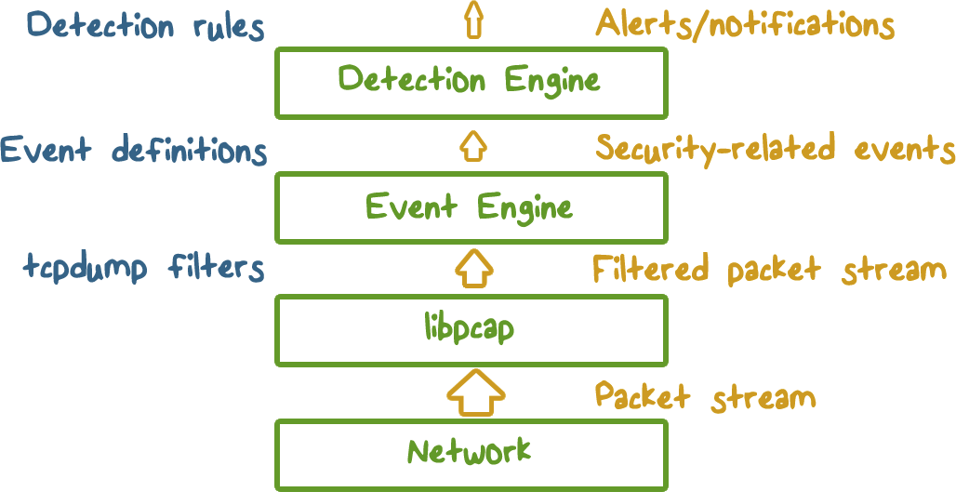
Architecture of Network IDS
Notes:
Instead, we can apply detection models to data that has higher base rate. This can be accomplished in a number of steps. First, we can apply filters to the packet data, e.g., by instructing libpcap to capture only packets to certain hosts and ports. Second, the event engine analyzes the filtered packet data and summarizes into security-related events, such a failed log-ins. Finally, detection models are applied to the security-related event data.
(Show in layers)
As we can see, the volume data is decreased first by the packet filter and then the event engine. Therefore, as long as we can keep the intrusion evidences in the event data, the base rate is going to be lot higher than the original packet data. As a result, the IDS model applied to event data will yield higher bayesian detection rate.

Slide 79
IDS Quiz
Check any item that is true. To improve detection performance, an IDS should:
Reduce false alarm rate while detecting as many intrusions as possible
Apply detection models at all unfiltered packet data directly
Apply detection models at processed event data that has higher base rate
Notes:
QUIZ: Discuss
SOLUTION: Discuss

Slide 80
Eluding Network IDS
What the IDS sees may not be what the end system gets
Ambiguities in protocols lead different implementations in operating systems:
E.G. TTL, fragments
Notes:
Attackers can defeat an IDS by exploiting the differences between the IDS and the end-host when they process the same traffic. TCP/IP protocol specifications have ambiguities that lead to different implementations in different operating systems. As a result, if the IDS runs on UNIX and the end-host runs on Windows, they may not process certain packets exactly the same way.
By exploiting these differences, the attacker hopes that the IDS would miss detecting the attack traffic, while the end-host will be affected by the attack traffic as intended by the attacker.

Slide 81
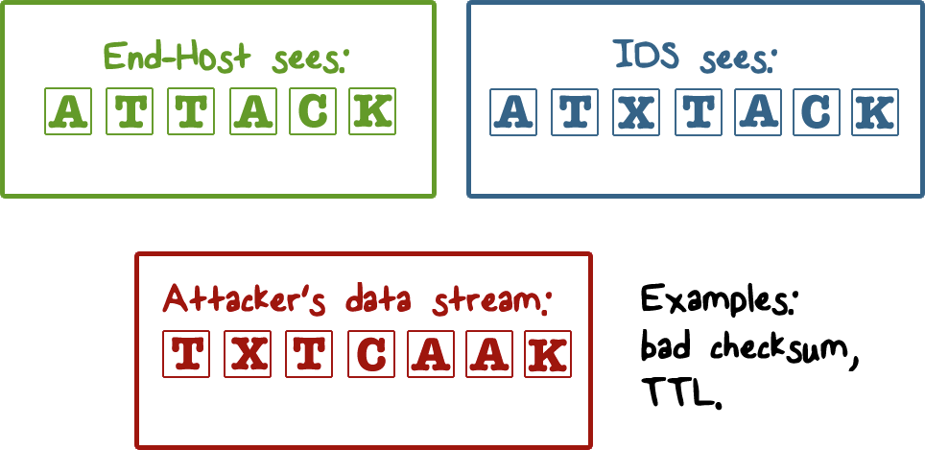
Insertion Attack
Notes:
Attacker can insert data into the packet stream to cause the IDS to miss detecting the attack.
For example, by including a packet with bad checksum, the end-host may reject this packet and yet the IDS will accept it. As a result, the end-host gets attacked and yet the IDS misses detecting it.
For example, the attacker sends these packets, although out of order, both the IDS and the end-host will assemble them according to the sequence numbers. One of them, X, has bad checksum: the IDS will accept it but the end-host will reject it.

Slide 82
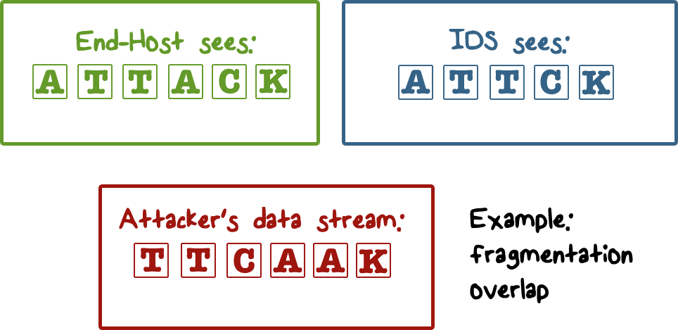
Evasion Attack
Notes:
Attacker can hide part of the attack and cause the IDS to miss detecting the attack.
For example, by sending fragments that overlap, the IDS may discard a fragment that overlaps with the previous fragment while the end-host may accept both. The result is that the IDS will miss the attack.
For example, in the attacker data, the two As overlap: the IDS will drop the second one but the end-host accepts both.

Slide 83

DoS Attacks on Network IDS
Resource exhaustion
CPU resources
Memory
Network bandwidth
Abusing reactive IDS
False positives
Nuisance attacks or “error” packets/connections
Notes:
Resource exhaustion similar to DoS attacks on a server, e.g., by sending a lot of traffic for the NIDS to process.
Abusing the reactive nature of IDS – it output alerts on attack traffic, and security admins may have to examine these alerts. The attacker can send a lot of traffic that will trigger alerts, e.g., by crafting packets that contain signatures of attacks. The goal is overwhelm the response systems and security admins, and the attacker can send realy attack traffic that even if it triggers alerts, will not be acted upon in time.

Slide 84
Intrusion Prevention Systems (IPS)
Also known as Intrusion Detection and Prevention System (IDPS)
Is an extension of an IDS that includes the capability to attempt to block or prevent detected malicious activity
Can be host-based, network-based, or distributed/hybrid
Can use anomaly detection to identify behavior that is not that of legitimate users, or signature/heuristic detection to identify known malicious behavior can block traffic as a firewall does, but makes use of the types of algorithms developed for IDSs to determine when to do so
Notes:
A further addition to the range of security products is the intrusion prevention system
(IPS), also known as intrusion detection and prevention system (IDPS). It is
an extension of an IDS that includes the capability to attempt to block or prevent
detected malicious activity. Like an IDS, an IPS can be host-based, network-based,
or distributed/hybrid. Similarly, it can use anomaly detection to identify behavior that is not that of legitimate users, or signature/heuristic detection to identify known malicious behavior.
Once an IDS has detected malicious activity, it can respond by modifying or blocking network packets across a perimeter or into a host, or by modifying or blocking system calls by programs running on a host. Thus, a network IPS can block traffic, as a firewall does, but makes use of the types of algorithms developed for IDSs to determine when to do so. It is a matter of terminology whether a network IPS is considered a separate, new type of product or simply another form of firewall.

Slide 85
IDS Attack Quiz
Check any item that is true. To defeat an IDS, attackers can:
Send a huge amount of traffic
Embed attack in packets what cause non-uniform processing by different operating systems, e.g., bad checksum, overlapping fragments
Send traffic that purposely matches detection rules
Send a packet that would trigger a buffer-overload in the IDS code
Notes:
QUIZ: Discuss
SOLUTION: Discuss

Slide 86
Intrusion Detection
Lesson Summary
Anomaly detection and misuse/signature detection
Network IDS, IPS, and honeypots
True positive, false positive, and the base-rate fallacy
Insertion, evasion, and DoS attacks on IDS
Notes:
In this lecture, we discussed the main intrusion detection approaches, in particular, the pros and cons of anomaly detection and misuse or signature detection.
There are several types of intrusion detection systems, including network IDS, intrusion prevention systems, and honeypots.
True positive and false positive rates are the most widely performance metrics. And the effect of false positive is highlighted by the base-rate fallacy.
IDS can be bypassed by insertion and evasion attacks, and disabled by DoS attacks.

